Slide 1



Name of the Project:
Sustainable Supply Chain Performance Dashboard Using Power BI
Presented by: Nalimeedi Rahul Leo Sri Chaitanya

Slide 2

Learning Objectives
To understand the fundamentals of data analytics and Power BI, apply analytical techniques to assess sustainable supply chain performance, and evaluate key revenue and defect rate metrics across products, suppliers, and carriers.
Understand the fundamentals of data analytics and Power BI.
Analyze a sustainable supply chain performance case study.
Evaluate total revenue and defect rates by product type.
Assess revenue contributions from SKUs, suppliers, and carriers.
Analyze sales distribution and transportation cost impact
GOAL
Source :
www.freepik.com/

Slide 3
Tools and Technology used
Power BI enabled seamless data visualization and analysis, helping to transform raw supply chain data into meaningful insights. It allowed for interactive dashboards, making it easier to track revenue, defect rates, and supplier performance. The platform’s powerful data modeling and filtering capabilities helped in refining key metrics for better decision-making.
ChatGPT assisted in structuring the project, generating insights, and improving the clarity of data interpretations. It provided explanations, summaries, and report enhancements, making complex analytical concepts more understandable. The combination of Power BI and ChatGPT streamlined the workflow, ensuring a comprehensive and well-organized analysis.

Slide 4
Methodology
Data Collection – Gathered supply chain data, including revenue, defect rates, and transportation costs.
Data Cleaning & Processing – Refined and structured raw data to ensure accuracy and consistency.
Power BI Integration – Imported the dataset into Power BI for visualization and analysis.
Dashboard Creation – Designed interactive dashboards to track key performance indicators.
Revenue & Defect Analysis – Examined total revenue by product type, SKUs, and suppliers.
Sales & Transportation Insights – Evaluated sales distribution and transportation cost impact.
Trend Identification – Used Power BI filters and charts to recognize patterns and anomalies.
ChatGPT Assistance – Generated summaries, explanations, and refined interpretations.
Report Generation – Compiled findings into a structured and data-driven report.
Conclusion & Insights – Derived key takeaways to enhance supply chain decision-making.

Slide 5
Problem Statement:
Efficient supply chain management is crucial for optimizing profitability and minimizing costs. This project analyzes sales, profits, and shipping costs across different states, cities, and regions using Power BI. By visualizing key metrics such as total sales, average profits, and shipping expenses, we aim to identify trends and inefficiencies. The insights from these charts will help businesses enhance decision-making, improve resource allocation, and streamline logistics for sustainable performance.

Slide 6
Solution:
The project utilizes Power BI for data visualization and ChatGPT for analytical insights, enabling an in-depth understanding of supply chain performance. By creating interactive dashboards, we identified trends in sales, profit margins, and shipping costs across different locations and categories. The bar, pie, and line charts helped in pinpointing high-revenue areas, cost-intensive shipping modes, and seasonal profit variations. These insights empower businesses to optimize inventory, enhance logistics, and improve overall efficiency, leading to a more sustainable and data-driven supply chain strategy

Slide 7
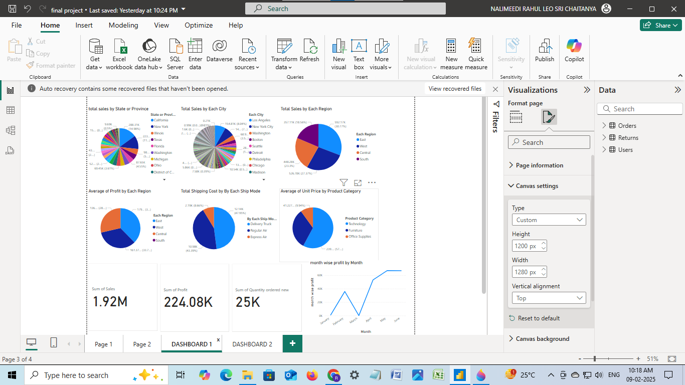
Screenshot of Output: Dashboard 1

Slide 8
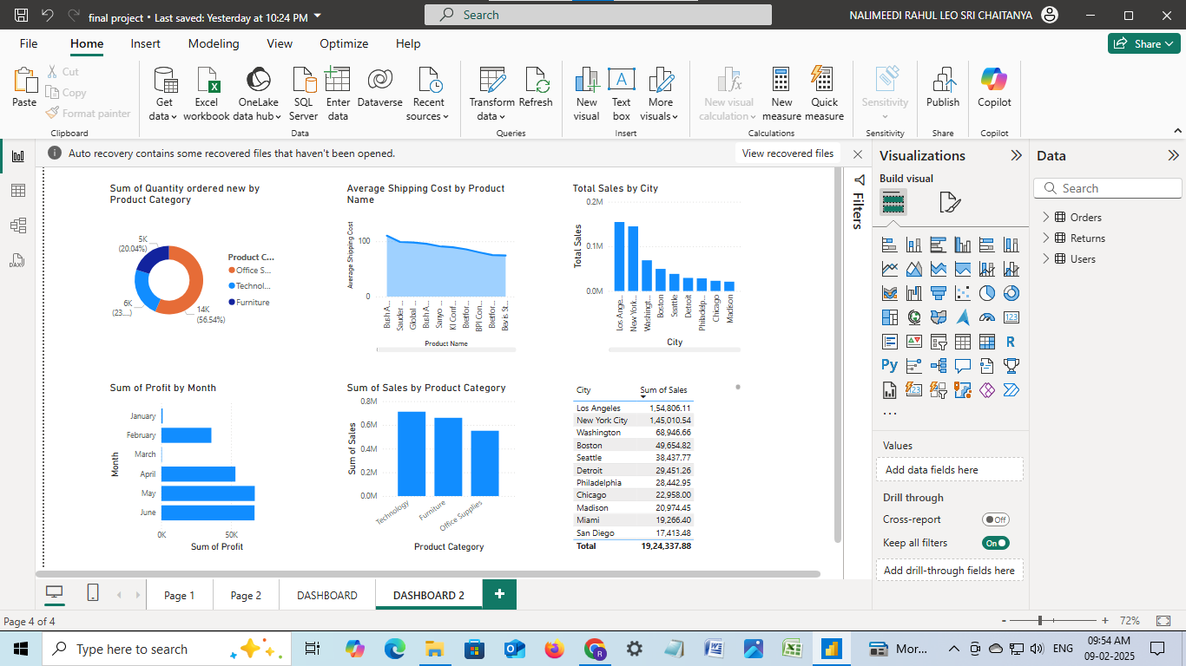
Screenshot of Output: Dashboard 2

Slide 9
Conclusion:
This project effectively utilized Power BI to analyze critical supply chain performance metrics, offering valuable insights into sales distribution, profitability trends, shipping costs, and product performance. The creation of interactive visualizations enabled data-driven decision-making, facilitating strategic optimizations in logistics, inventory management, and cost efficiency. Additionally, ChatGPT-assisted analysis enhanced data interpretation and report structuring, ensuring a comprehensive evaluation of key business indicators. These findings underscore the significance of data analytics in driving operational efficiency, improving resource allocation, and fostering a more sustainable supply chain framework.

